Slide 1
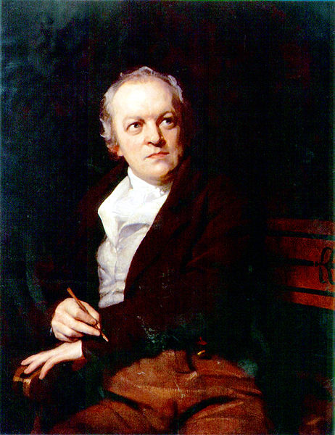

William Blake
1757 – 1827
English poet, painter
and printmaker
portrait
by Thomas Phillips(1807)

Slide 2
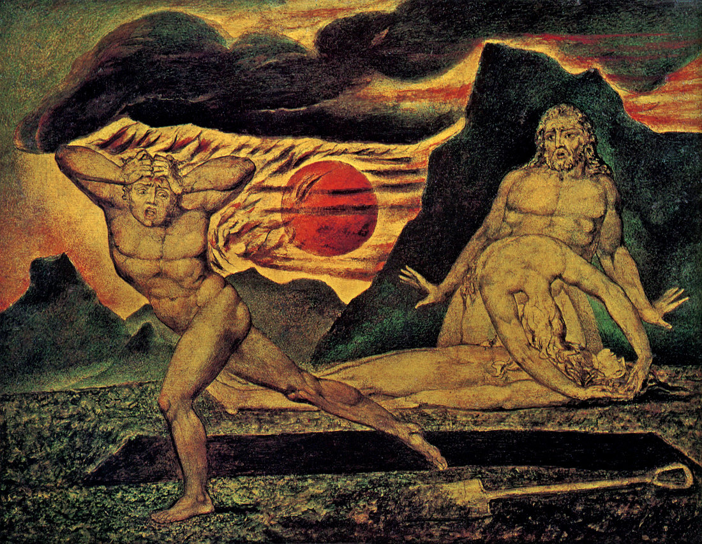
Cain flees(창4:13)
The Body of Abel Found by Adam and Eve
1825

Slide 3
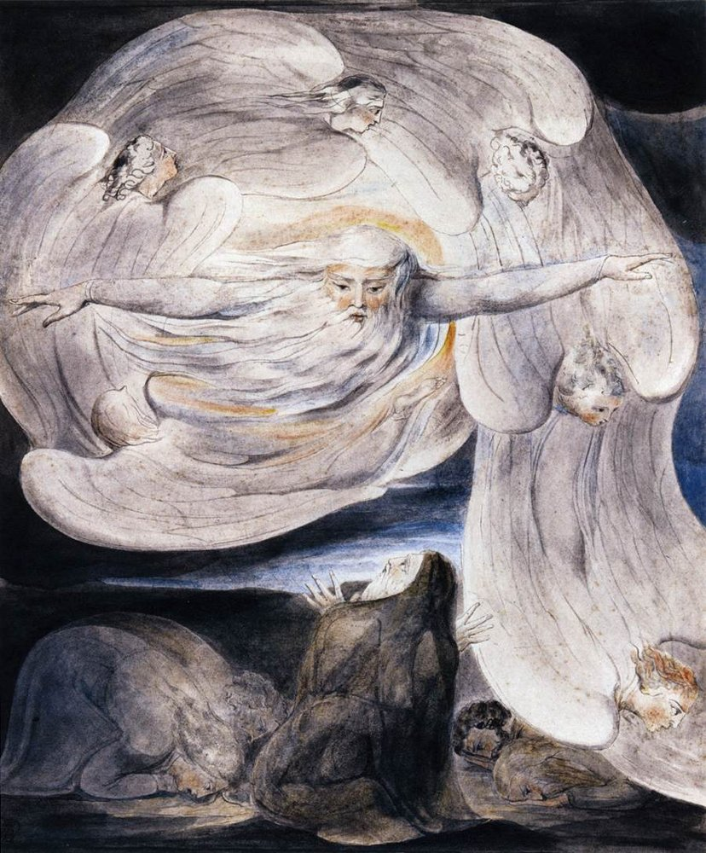
God answers Job
(욥38:1)
1804

Slide 4
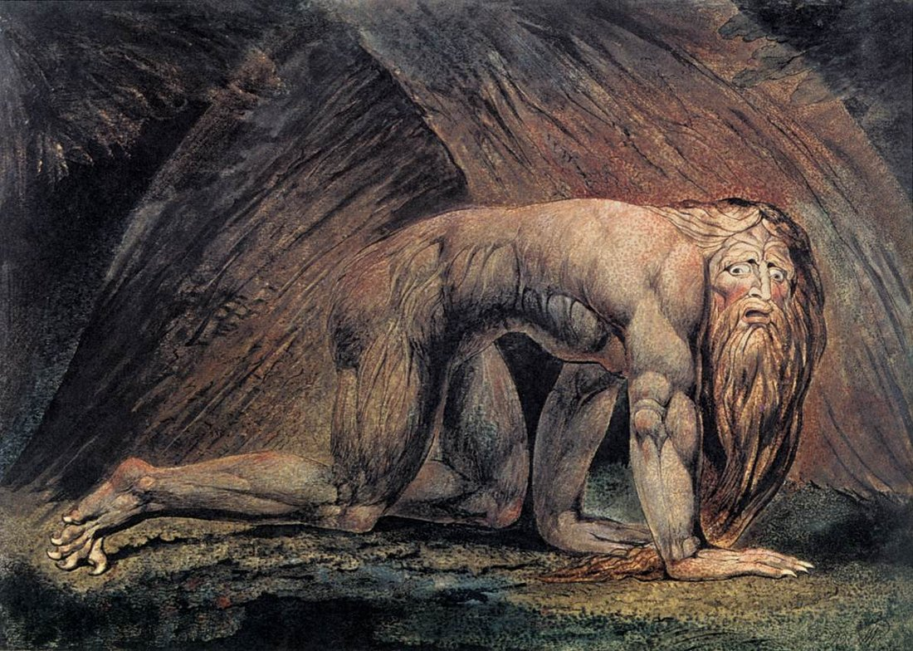
Nebuchadnezzar
(단4:33)
1795

Slide 5
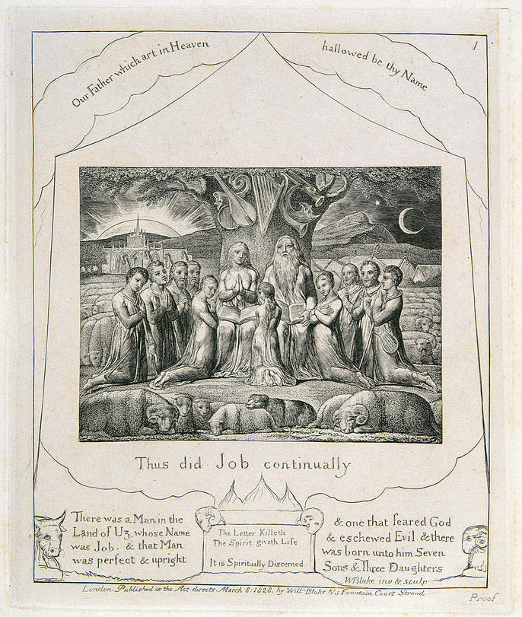
The Book of Job – 01
(욥1:5)
Job and His Family
1826

Slide 6
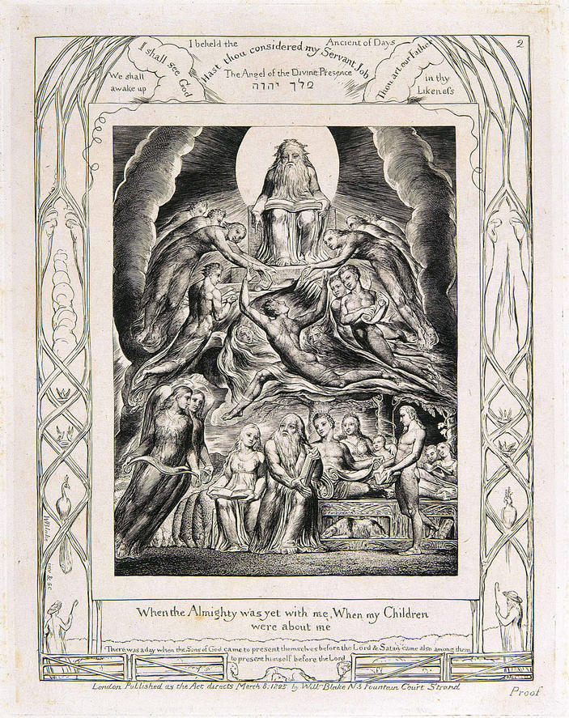
The Book of Job – 02
(욥29:5)
Satan Before the Throne of God

Slide 7
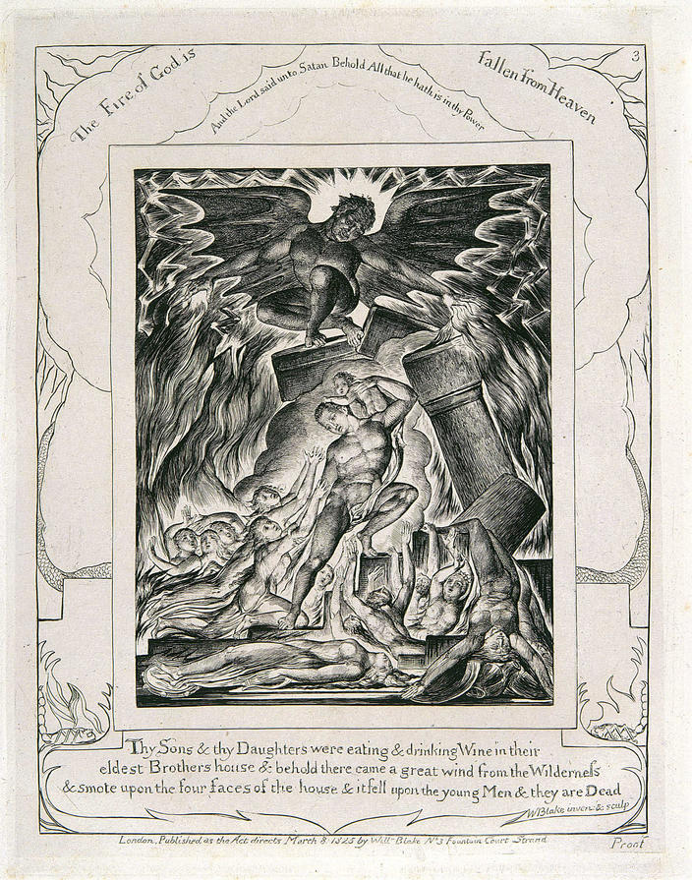
The Book of Job – 03
(욥1:18)
Job's Sons and Daughters Overwhelmed by Satan

Slide 8
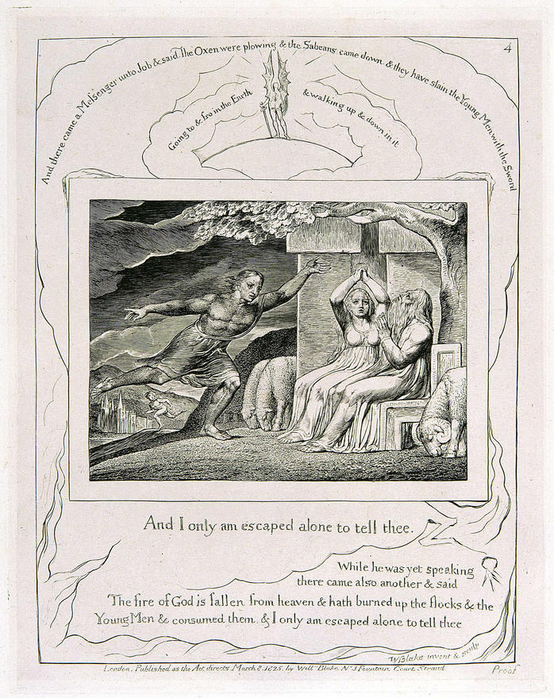
The Book of Job – 04
(욥1:15)
The Messengers Tell Job of His Misfortunes

Slide 9
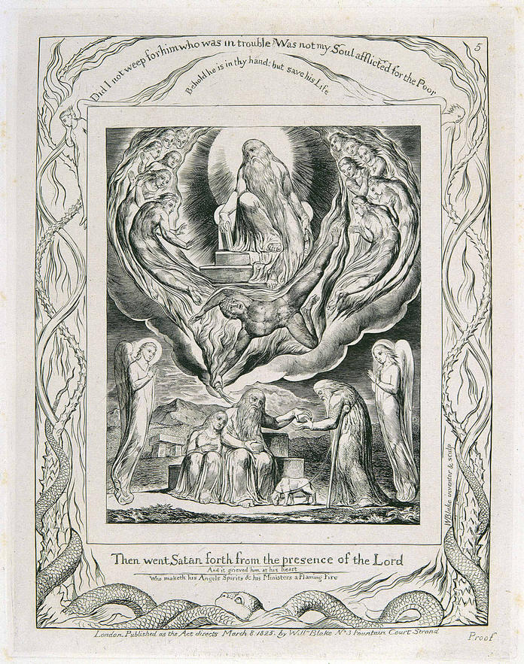
The Book of Job – 05
(욥2:7)
Satan Going Forth from
the Presence of the Lord
and Job's Charity

Slide 10
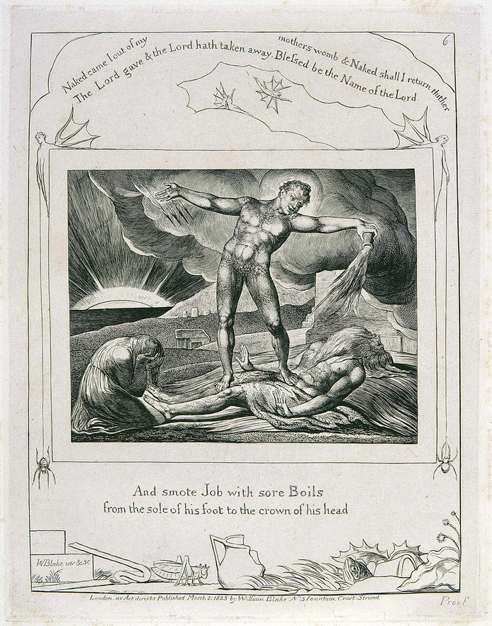
The Book of Job – 06
(욥2:7)
Satan Smiting Job with Boils

Slide 11
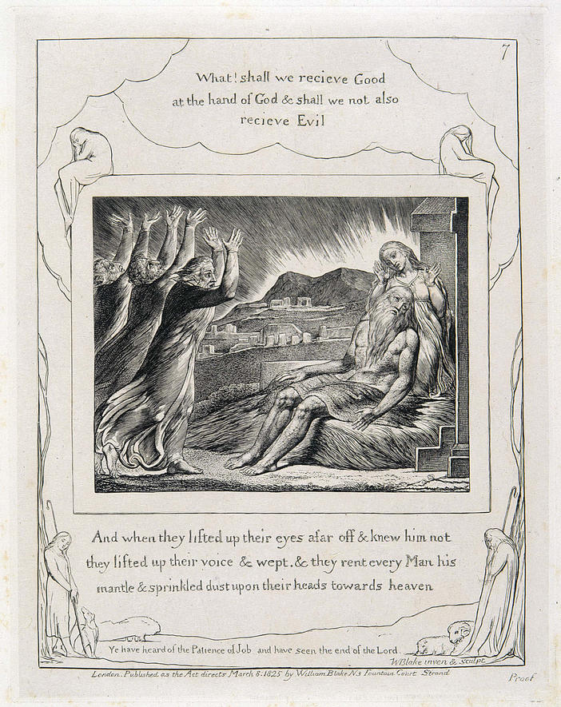
The Book of Job – 07
(욥2:12)
Job's Comforters

Slide 12
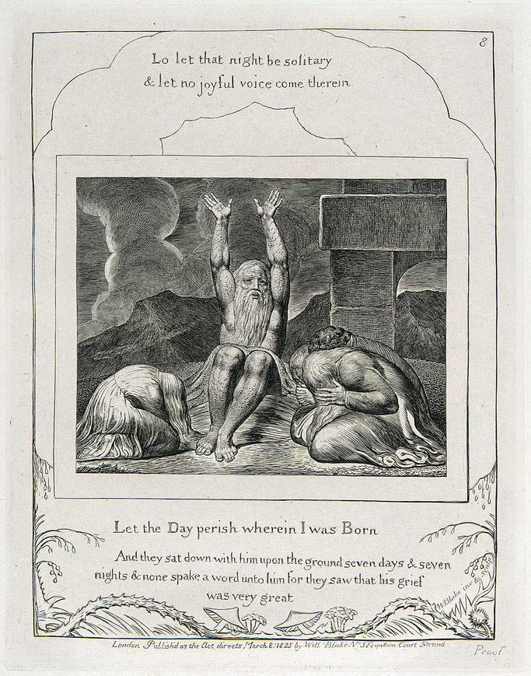
The Book of Job – 08
(욥3:3)
Job's Despair

Slide 13
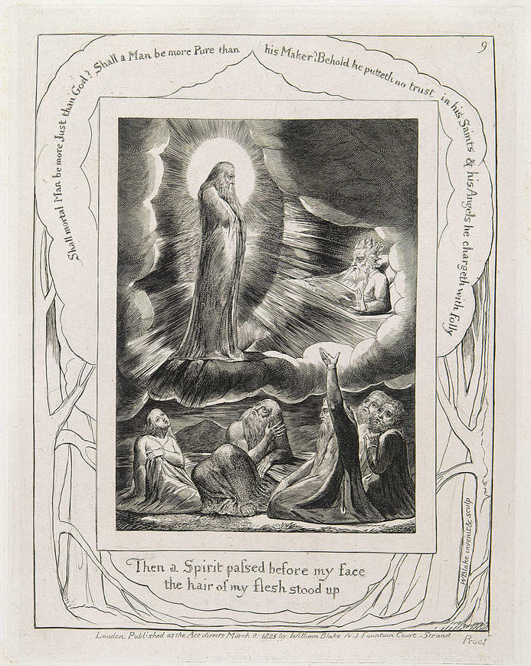
The Book of Job – 09
(욥4:15)
The Vision of Eliphaz

Slide 14
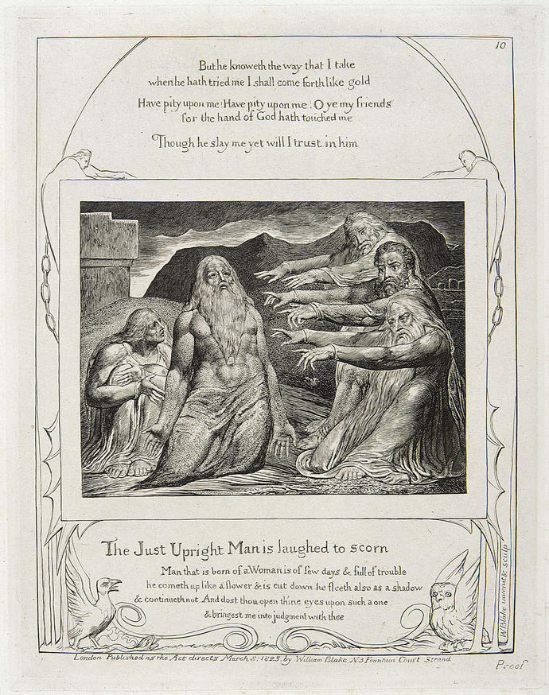
The Book of Job – 10
(욥12:4)
Job Rebuked by His Friends

Slide 15
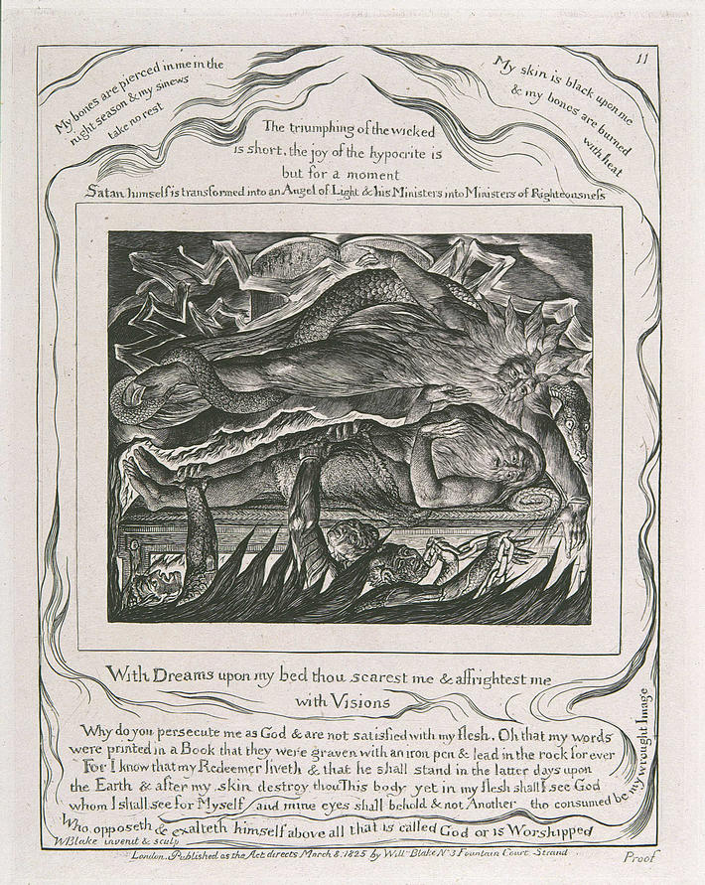
The Book of Job – 11
(욥7:14)
Job's Evil Dreams

Slide 16
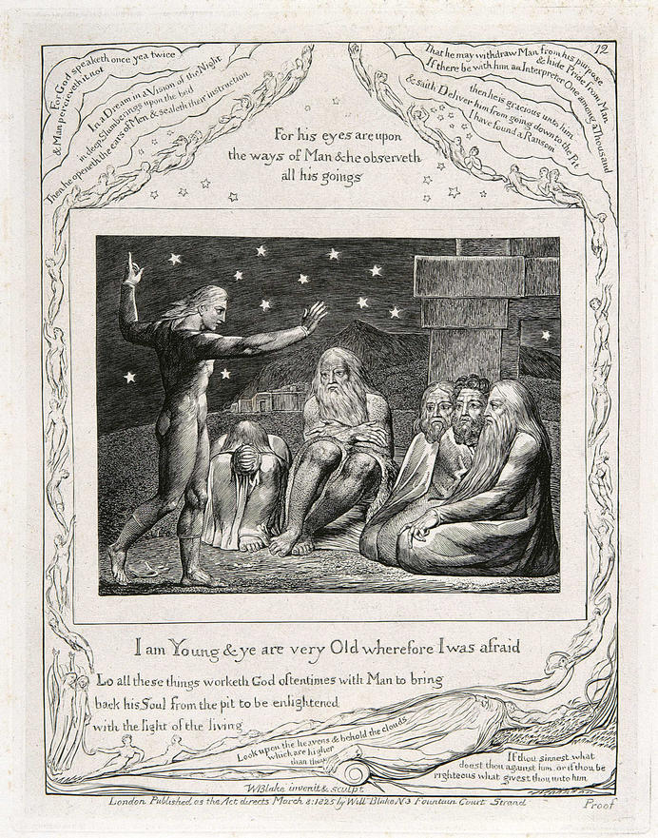
The Book of Job – 12
(욥32:6)
The Wrath of Elihu

Slide 17
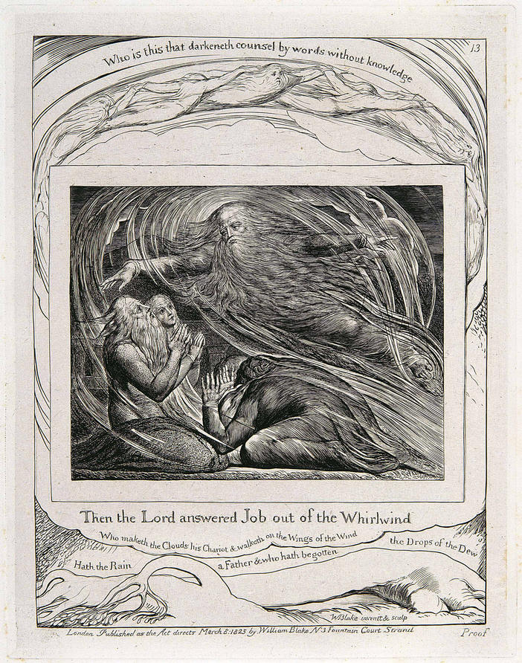
The Book of Job – 13
(욥38:1)
The Lord Answering Job
out of the Whirlwind

Slide 18
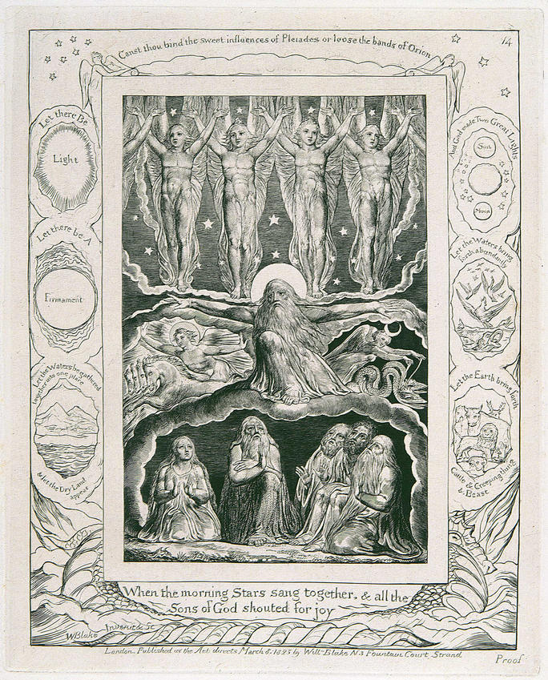
The Book of Job – 14
(욥38:7)
When the Morning Stars
Sang Together

Slide 19
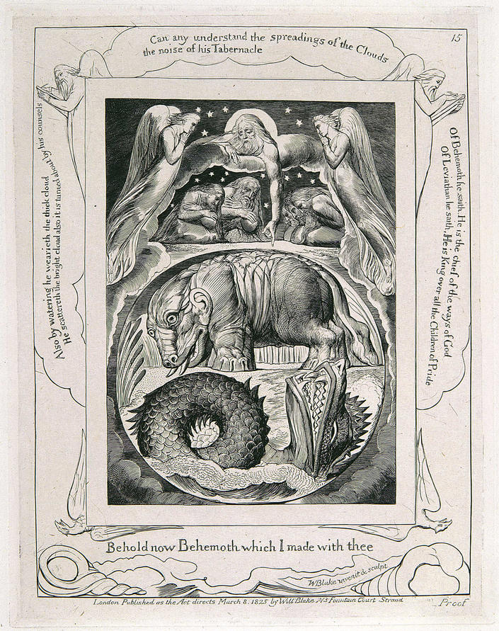
The Book of Job – 15
(욥40:15)
Behemoth and Leviathan

Slide 20
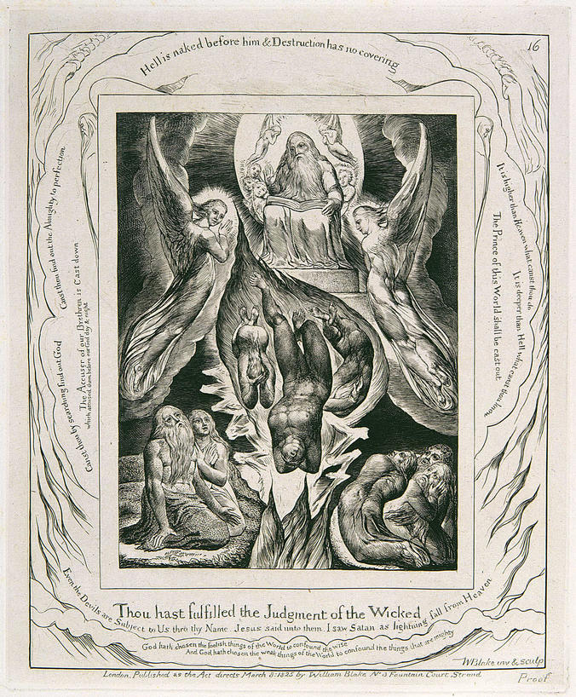
The Book of Job – 16
(욥36:17)
The Fall of Satan

Slide 21
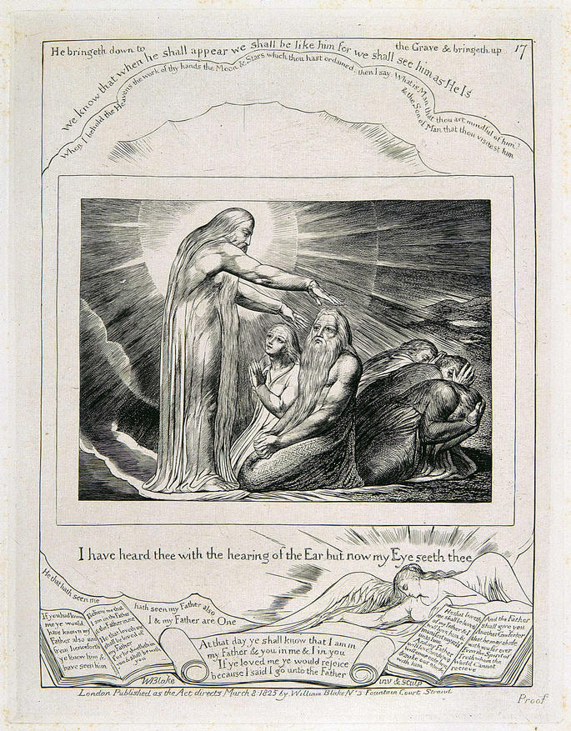
The Book of Job – 17
(욥42:5)
The Vision of Christ

Slide 22
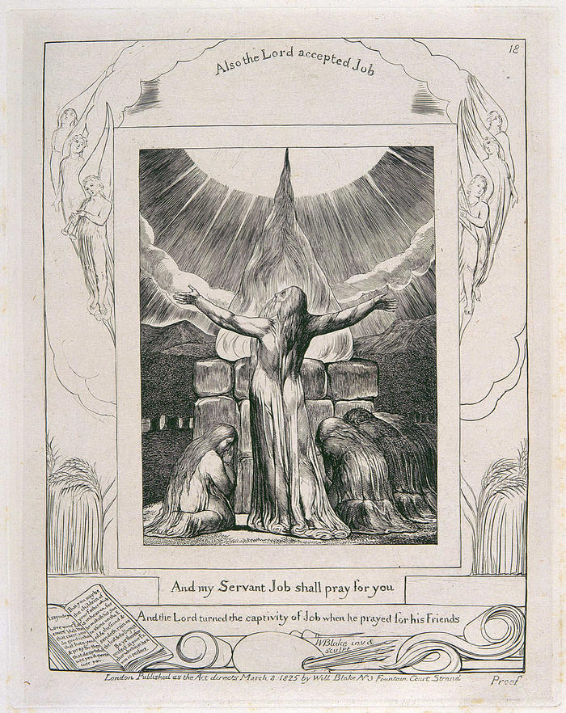
The Book of Job – 18
(욥42:8)
Job's Sacrifice

Slide 23
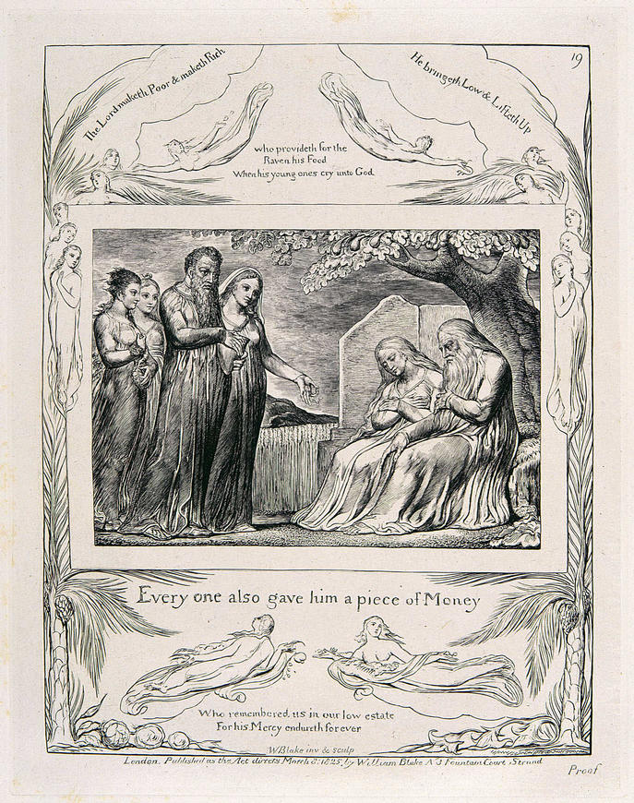
The Book of Job – 19
(욥42:11)
Every one also gave him
a piece of Money

Slide 24
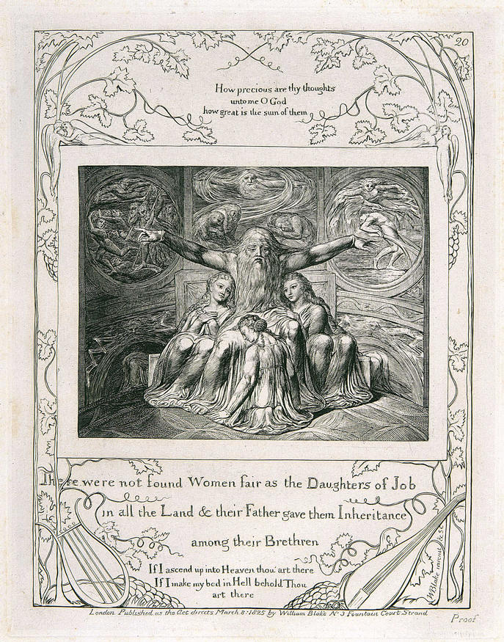
The Book of Job – 20
(욥42:15)
Job and His Daughters

Slide 25
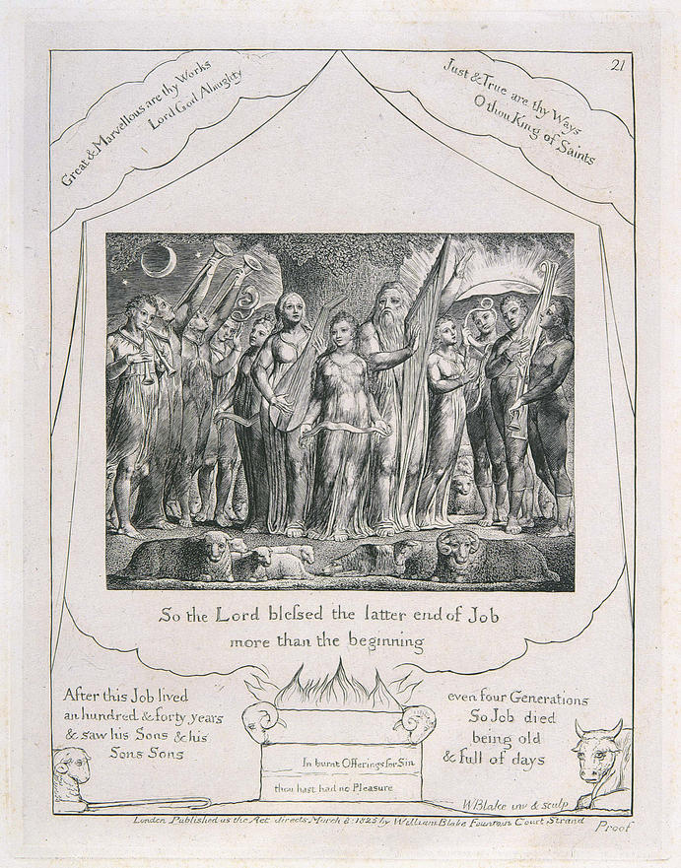
The Book of Job – 21
(욥42:12)
Job and His Family Restored
to Prosperity

